Slide 1
Chapter Thirteen
Operating System Basics

Slide 2


220-902 Objectives Covered
1.1 Compare and contrast various features and requirements of Microsoft Operating Systems (Windows Vista, Windows 7, Windows 8, Windows 8.1).
1.4 Given a scenario, use appropriate Microsoft operating system features and tools.
1.7 Perform common preventive maintenance procedures using the appropriate Windows OS tools.
2.2 Given a scenario, set up and use client-side virtualization.
3.3 Compare and contrast differences of basic Windows OS security settings.

Slide 3
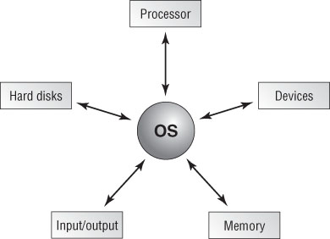
The operating system interacts with resources.
Notes:
Operating system (OS)
The operating system provides a consistent environment for other software to execute commands.
The OS provides users with an interface with the computer so that they can send commands (input) and receive feedback or results (output).
OS communicates with Hardware to perform these tasks:
Disk and File management
Device access
Memory Management
Output format
Applications
Software that is written to supplement the commands available to a particular OS
Relies on OS; they ask the OS to access memory and devices - e.g. MS word, IE Explorer etc.
Defin: Program written to perform specific tasks and functions for the user.
Drivers
Specific software that instructs the OS on how to access a particular hardware

Slide 4
OS Concepts and Basics
Version
Source Code
Shell
Graphical User Interface
Network
Cooperative Multitasking
Pre-emptive Multitasking
Multithreading
32bit, 64bit,x86,x64
Notes:
A shell is a program that runs on top of the OS and allows the user to issue commands through a set of menus or another interface (which may or may not be graphical). Shells are either Command Line Interface or Graphical User Interface
Graphical user interface, or GUI, is a method by which a person communicates with a computer using graphical images, icons, and methods other than text.
A network is any group of computers that have a communication link between them.

Slide 5
OS Concepts and Basics
Version
Source Code (open source/closed source)
Notes:
A version is a particular revision of a piece of software, normally described by a number that tells you how new the product is
The source code is the actual code that defines how a piece of software works. Open Source (can be modified by anyone). Closed Source(1 developer can modify the code)

Slide 6
OS Concepts and Basics
Cooperative Multitasking
Pre-emptive Multitasking
Multithreading
32bit, 64bit,x86,x64
Notes:
Cooperative multitasking (OLD) - is a multitasking method that depends on the application itself to be responsible for using the processor and then freeing it for access by other applications. Older versions of Windows used this method; if application locked up it locked the system requiring a reboot
Preemptive multitasking is a multitasking method in which the OS allots each application a certain amount of processor time and then forcibly takes back control and gives another application or task access to the processor.
Multithreading is the ability of a single application to have multiple requests in to the processor at one time. This results in faster application performance because it allows a program to do many things at once.

Slide 7
OS Concepts and Basics
32bit OS
64bit OS
x86 OS
x64 OS
Notes:
32bit OS can run on a 32bit processor and utilize the processors’ capabilities
64bit OS can run on a 64bit processor and utilize the processors’ capabilities.
** You cannot run a 64 bit software on a 32bit OS but you can run a 32bit software on a 64bit OS
X86 (Intel) – refers to 32bit OS that run on Intel processors that were 32bit and ended with 86 before Pentium was developed
X64 (AMD) – refers to 64bit OS that run on AMD64 developed by AMD

Slide 8
OS Concepts and Basics
Cooperative Multitasking
Pre-emptive Multitasking
Multithreading
32bit, 64bit,x86,x64
Notes:
Preemptive multitasking is a multitasking method in which the OS allots each application a certain amount of processor time and then forcibly takes back
control and gives another application or task access to the processor.
Cooperative multitasking is a multitasking method that depends on the application itself to be responsible for using the processor and then freeing it for access by other applications. Older versions of Windows used this method; if application locked up it locked the system requiring a reboot

Slide 9
OS Concepts and Basics
Cooperative Multitasking
Pre-emptive Multitasking
Multithreading
32bit, 64bit,x86,x64
Notes:
Preemptive multitasking is a multitasking method in which the OS allots each application a certain amount of processor time and then forcibly takes back
control and gives another application or task access to the processor.
Cooperative multitasking is a multitasking method that depends on the application itself to be responsible for using the processor and then freeing it for access by other applications. Older versions of Windows used this method; if application locked up it locked the system requiring a reboot

Slide 10
Minimum System Requirements
Determining hardware compatibility and minimum requirements
Determining installation options
Determining the installation method (clean vs upgrade)
Preparing the computer for installation
Notes:
Can the Hardware handle the version of Windows you intend to install?
Microsoft developed several versions of its Hardware Compatibility List (HCL) – List of all Hardware that work with what version of Windows
Windows Catalog – Replaced HCL and included Software. Later it became the:
Compatibility Center
Minimum Specifications - are the absolute minimum requirements for hardware
your that system should meet in order to install and run the OS version
Recommended Hardware Specifications - are what you should have in your system in
order to realize usable performance. Aim to have this or better
Se Tables 13.1, 13.2, 13.3

Slide 11
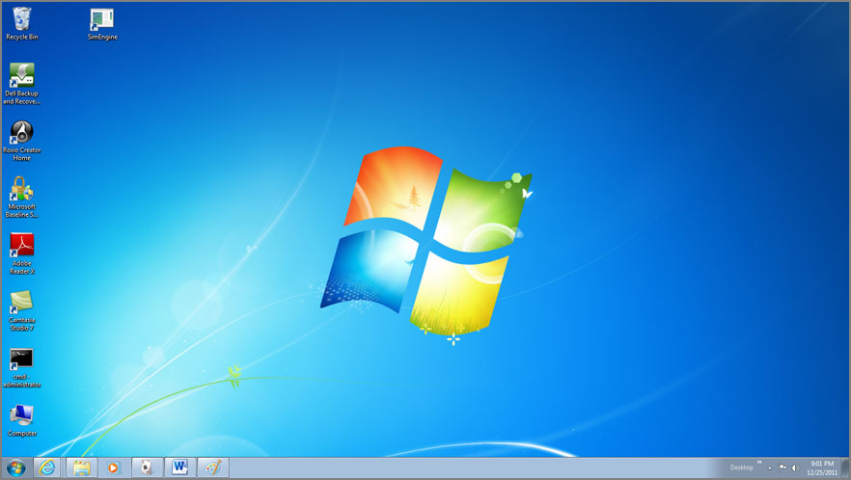
The Windows 7 Interface
Notes:
looks similar to the older interfaces (Windows XP)

Slide 12
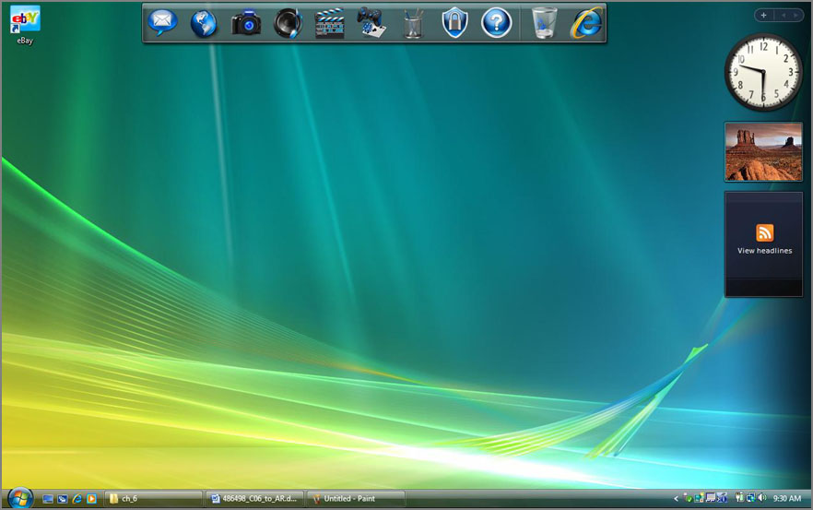
The Windows Vista Interface
Notes:
Between the older interfaces and Windows 7, Microsoft released Windows Vista and the Aero interface (Authentic, Energetic, Reflective and Open)
Not well received

Slide 13
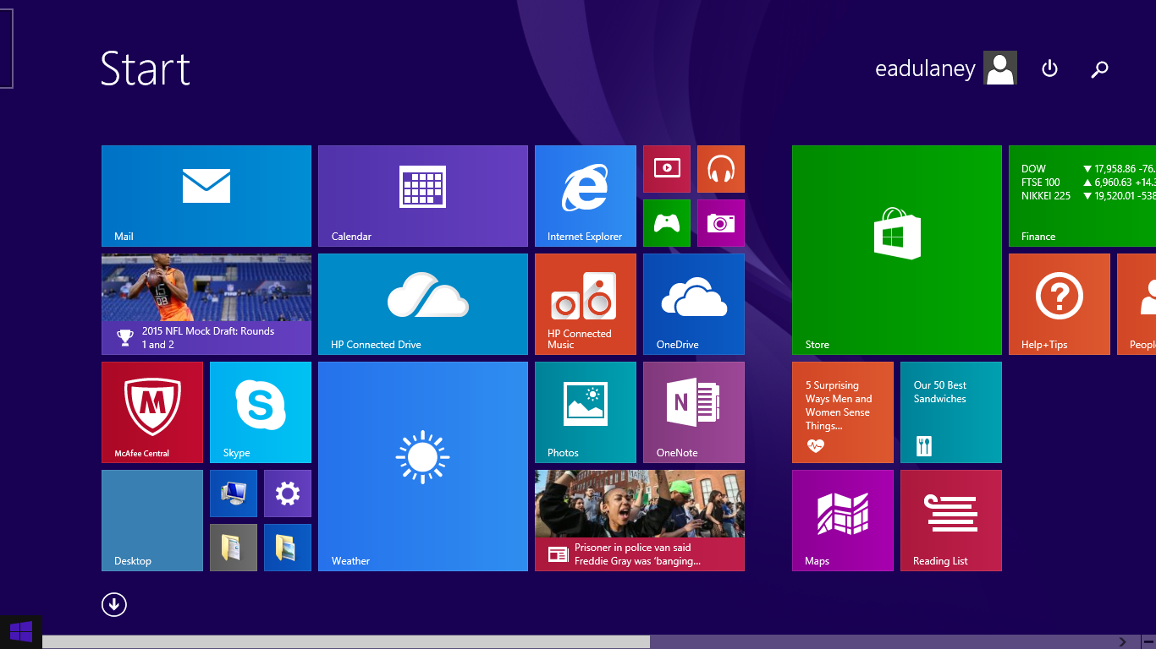
The Windows 8 interface
Windows 8/8.1 hid the Start menu and used graphical tiled interface.
Notes:
Borrowed from the best of Windows 7 and Windows Vista
This was originally called the Metro interface, but the name was changed after its release to the new Windows UI

Slide 14
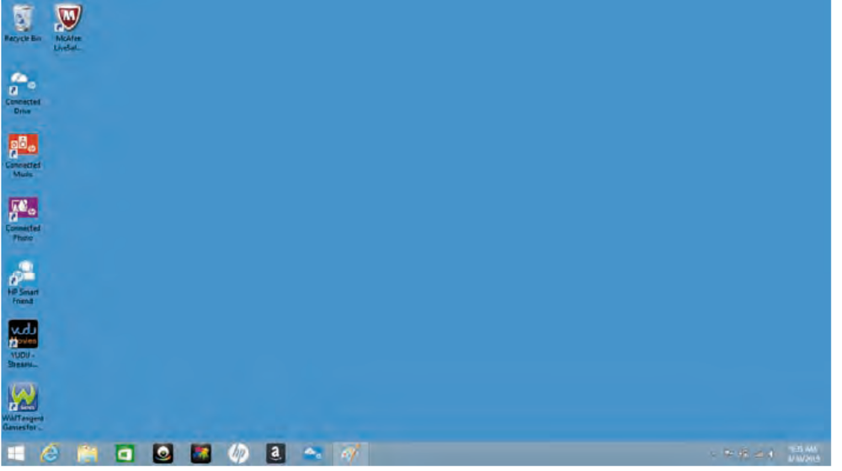
Desktop
The Windows 8 interface
Notes:
The Desktop is the virtual desk on which all of your other programs and utilities run. Contains:
Start Menu
Taskbar
Several Icons – Application shortcuts

Slide 15
Windows Mouse Possibilities
Primary click (L)– selects and object
Double click – Opens a program
Secondary click (R)– displays context-sensitive menu

Slide 16
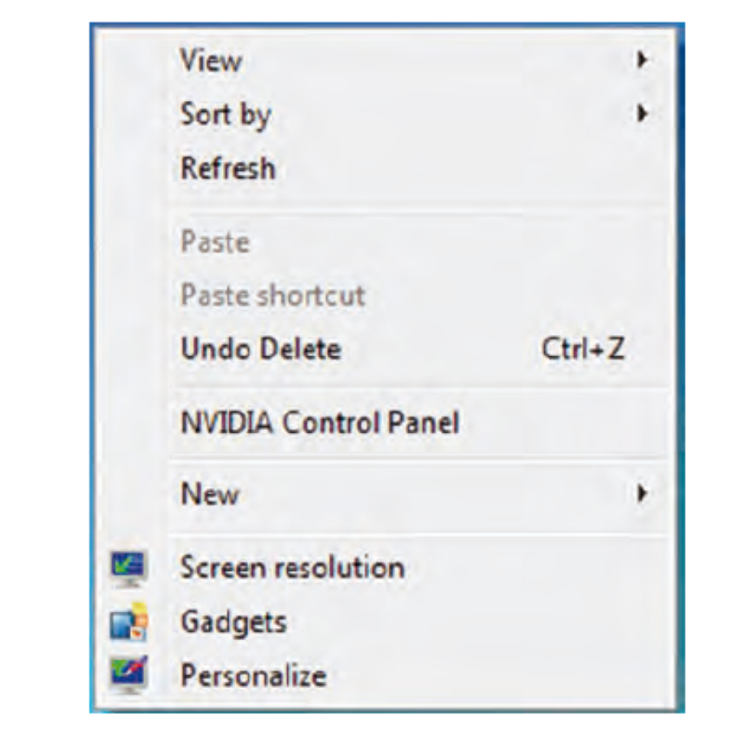
Right Click Desktop--Personalize
The Windows 7 Desktop context menu
Ex 13.1 Changing a Screensaver
Notes:
You can change the background patterns, screensaver, color scheme, and size of elements on the Desktop by right-clicking in any area of the Desktop that doesn’t contain an icon
Personalization (or Themes) Selecting a theme sets several items at once, such
as a picture to display on the Desktop, the look of icons, sounds to use, and so on. Desktop Background The Background tab is used to select a picture to display on the
Desktop.
Screen Saver Sets up an automatic screensaver to display on your screen if your
Computer has been inactive for a certain period of time. Originally used to prevent
burn-in of monitors, screensavers are now generally used for entertainment or to
password-protect users’ desktops.
Window Color (and Appearance) Used to select a color scheme for the Desktop or to
change the color or size of other Desktop elements.
Change Display Settings Used to set the color depth or screen size. Also contains the
Advanced button, which leads to graphics driver and monitor configuration settings.
In Exercise 13.1, how to change a screensaver

Slide 17
Taskbar
Contains two major items
Start Menu
System Tray (systray)
Notes:
The Start menu is on the left side of the Taskbar and is easily
identifiable: It is a button that has the word Start on it
The system tray is located on the right side of the Taskbar and
contains only a clock by default, but other Windows utilities (for example, screensavers or antivirus utilities) may put their icons
When you open a new window or program, it gets a button on the center of the Taskbar with an icon that represents the window or program as well as the name of the window or program.

Slide 18
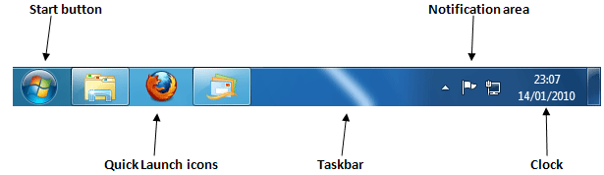
Taskbar
EX 13.2 Auto-Hiding the Taskbar
Notes:
A special area on the Taskbar to the right of the Start button is known as the Quick Launch area, and icons of commonly used programs can appear here, allowing the programs to be started with a single click

Slide 19
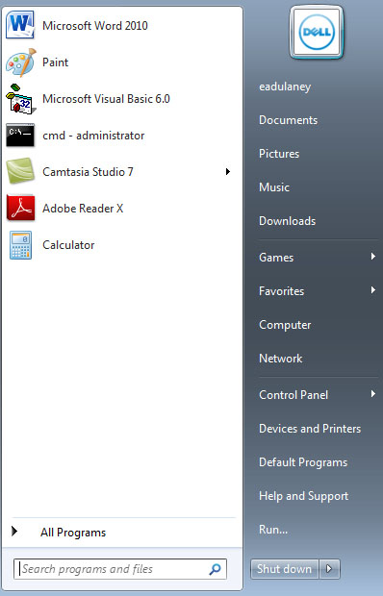
The Start Menu
Notes:
There are slight differences between the Start menu in Windows 7 and the one it Windows Vista, but they all behave the same.

Slide 20
The Windows 8 Start Menu
Right Click Start Menu and a pop up menu appears

Slide 21
Icons
Are Program Shortcuts with these elements:
Icon Label
Icon Graphic
Program Location Path

Slide 22
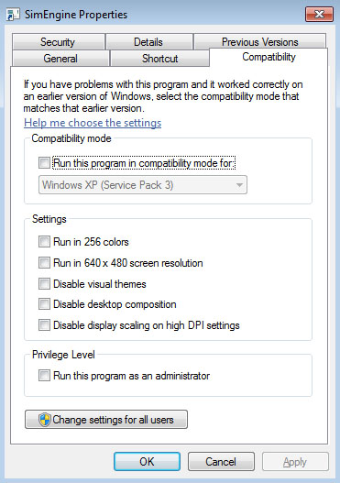
Compatibility Settings
Notes:
Additional functionality has been added to an icon’s properties to allow for backward compatibility with older versions of Windows (known as compatibility mode).

Slide 23
Standard Desktop Icons
Computer Icon
Network
Recycle Bin

Slide 24
All Programs Submenu
Recent Items Submenu
Search Box
Help and Support Command (F1)
Run Command (on Start Menu)
EX 13.3 Starting a Program from the Run Window

Slide 25
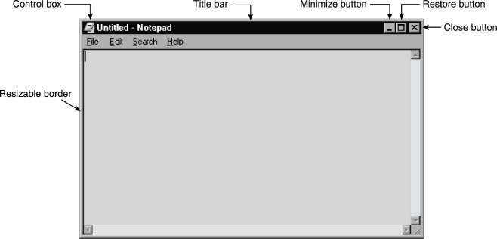
Elements of a Window
Notes:
A program window is a rectangular area created on the screen when an application is
opened within Windows
Control Box – Max, Min, Close application
Min, Max, Restore – changes state of a window
Close – Ends program
Title Bar – States Name of the program
Menu bar – Has useful commands within an application
Border – Thin line that surrounds the entire window, allows resizing
Active Window – Window currently in use. Any window that overlap it are moved behind and every keystroke affect the active window

Slide 26
States of a Window
Maximize
Restore
Minimize
Notes:
Maximized A maximized window takes up all of the available space on the screen
Restored A restored window can be used interactively, and it is identical in function to a maximized window, with the simple difference that it does not necessarily take up the entire screen. Restored windows can be very small, or they can take up as much space as maximized windows.
Minimized - program windows are represented by nothing but an icon and title on the Taskbar, and they are not usable until they have been either maximized or restored. The difference between a minimized program and a closed program is that a minimized program is out of the way, but it is still taking up resources and is therefore ready to use if you need it.

Slide 27
Windows Update
A feature designed to keep Windows current by automatically downloading and installing updates such as patches and security fixes
EX 13.4 Configuring Windows Update

Slide 28
Restore Points
A restore point is a copy of your system configuration at a given point in time
Start ➢ All Programs ➢ Accessories ➢ System Tools ➢ System Restore
Ex 13.5 Manually Creating a Restore Point in Windows
Notes:
1. Windows creates them automatically by default.
2. You can manually create them yourself (which is highly recommended) before you make any significant changes to the system, such as installing new drivers.
3. During the installation of some programs, a restore point is created before the installation; that way, if the install fails, you can “roll back” the system to a pre-installation configuration.

Slide 29
File Management
File management is the process by which a computer stores data and retrieves it from storage
Follows a set of rules

Slide 30
Filename Rules
Maximum of 255 Characters
? / \ - reserved and not used
A filename extension (3-4 characters) used to identify file type
Are NOT case sensitive
2 files cannot have exactly the same name and path.
Notes:
A path indicates the location of the file on the disk
Windows 3.x and DOS filenames were limited to 8 characters and 3 character extension (i.e.8.3 filename system)

Slide 31
EXPLORER
View files and directories
Open programs or data files
Create directories and files
Copy objects to other locations
Move objects to other locations
Delete or rename objects
Change file attributes
Notes:
The ability to use drag-and-drop techniques and other graphical tools to manage the file system makes the process far simpler, and EXPLORER is a utility that allows you to accomplish a number of important file-related tasks from a single graphical interface

Slide 32
File Permission
They control who has access and what type of access they have to what files or folders
Standard permissions: Full Control, Modify, Read & Execute, Read and Write
EX13.6 Examining File Permissions
Notes:
Ex 13.6 Examining File Permissions
You can assign permissions to individual users or to groups. You assign standard
permissions on the Security tab of a file or folder, which you access through the file or
folder’s properties

Slide 33
Going Virtual
Hypervisor is a virtual machine manager—the software that allows the virtual machines to exist.
In the Microsoft client OS realm, the built-in hypervisor is the Microsoft Virtual PC. Other options include VMware and Xen.

Slide 34
Virtual Concerns
There have been a number of virtualization-specific threats that have cropped up focusing on the hypervisor, but updates have fixed the issues as they have become known.
The solution to most virtual machine threats is to always apply the most recent updates and keep the system(s) up-to-date.

Slide 35
Virtual Networking
Virtual desktops are often used with remote administration, allowing a remote administrator to work on the workstation with or without the knowledge of the user sitting in front of the machine.
The resource requirements for virtualization are largely based upon what environments you are creating.
Notes:
The virtual desktop is often called a virtual desktop interface (VDI), and that term
encompasses the software and hardware needed to create the virtual environment.
Hardware-assisted virtualization allows the hypervisor (the virtualization product) to allocate memory and CPU dynamically to the VMs as required

Slide 36
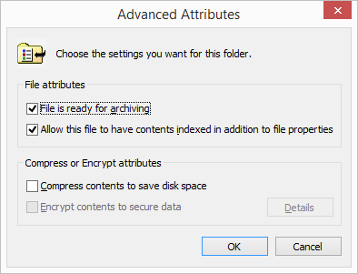
Advanced File Attributes
Notes:
FAT32 does not have as many options as NTFS, such as Encryption and Compression
Archiving The archiving option can be used to tell the system whether or not the file
has changed since the last time it was backed up.
Indexing Windows implements a feature called the Indexing Service to catalog and
improve the search capabilities of your drive. Once files are indexed, you can search for them more quickly by name, date, or other attributes. Setting the index option on a folder
Compression The versions of Windows that you need to know for the exam support
advanced compression options, which were first introduced in Windows NT. NTFS files
and folders can be dynamically compressed and uncompressed, often saving a great deal of space on the drive.
Encryption Encryption lets you secure files so that no one else can view them; you
encrypt files by encoding them with a key to which only you have access

